Slide 1
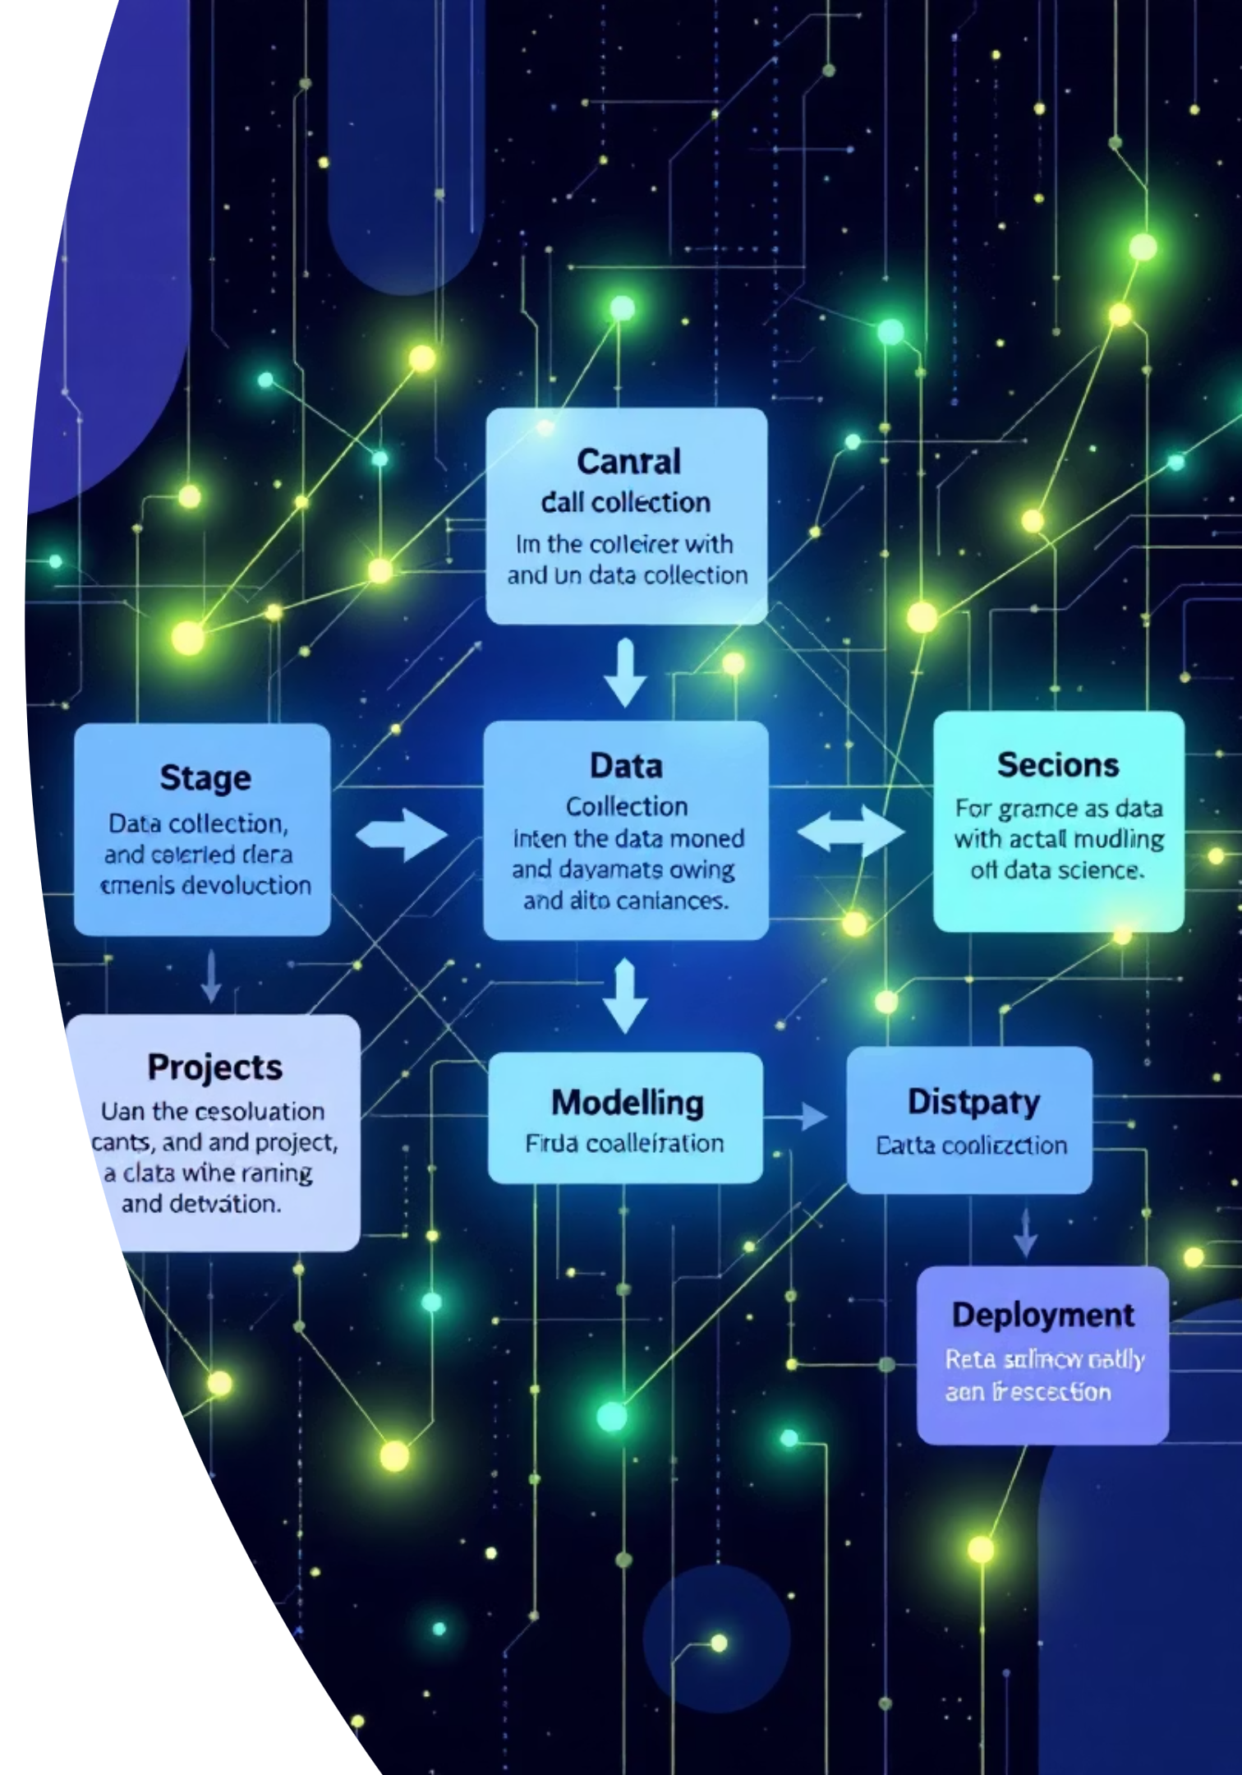
The life cycle of a data science project
Transforming raw data into actionable insights.
Presenter - May Zin Tun

Slide 2
General steps of a data science project -
Business Understanding/Problem Definition
Data Acquisition and Exploration
Data Preparation
Modeling
Evaluation
Deployment and Integration
Monitoring and Improvement

Slide 3

Business Understanding/Problem Definition
Identify the Business Objective - What is the organization trying to achieve?
Example -> Reduce customer churn by 10% in the next quarter.
2. Gather Background Information - review previous reports, industry studies, or past projects.
Not understanding the context leads to misinterpretation of the data and
results.
3. Define Clear Objectives and Scope - translating the business problem into a data science problem and clarify boundaries.
Data Science Problem: Build a model to predict which customers are most likely to churn in the next quarter.
Scope: Use past 2 years of customer data (transactions, support interactions, product usage). Exclude customers with less than 3 months of history (not enough signals).
If the business problem isn’t clearly defined, the results might be end up scattered, misaligned.

Slide 4
Data Collection
Purpose
Gather the data identified during problem definition.
Key Steps
Identify Data Sources
- Internal: databases, ERP, transaction logs.
- External: APIs, open datasets, surveys, web scraping.
2. Ensure Data Quality
- Check completeness, accuracy, consistency.
3. Document Metadata
- Record source, ownership, frequency of updates.
Poor data collection can lead to inaccurate analysis and flawed outcomes.

Slide 5
Exploratory Data Analysis (EDA)
Purpose
Understand the data before modelling.
Detect patterns, trends, and anomalies.
Validate assumptions.
Key Steps
Summarize the Data
- Descriptive statistics (mean, median, standard deviation).
- Distribution of variables.
Visualize the Data
- Histograms, scatter plots, boxplots, correlation heatmaps.
- Spot outliers and relationships.
3. Check Relationships
- Correlations between features.
Generate Hypotheses
- Example: “High support call frequency may lead to higher churn.”
Tools
R and Python (Pandas, Matplotlib, Seaborn),
Excel,
Power BI or Tableau

Slide 6
Data Preparation
Purpose
Transform raw data into clean, usable form for modeling.
Key Steps
Data Cleaning
- Handle missing values.
- Remove duplicates & outliers.
- Standardize formats (dates, currencies, units).
2. Feature Engineering
- Create new meaningful variables.
- Encode categorical variables (one-hot, label encoding).
- Scale/normalize numerical features.
3. Data Transformation
- Aggregate or filter data.
- Reduce dimensionality if needed (PCA, feature selection).
4. Data Splitting
- Train set, validation set, test set.
- Sometimes also time-based splits for time series.
Tools
R and Python (Pandas, Numpy),
SQL
Balancing between removing noise and losing valuable information.
Maintaining reproducibility of preprocessing steps.

Slide 7
Modeling
Purpose
Apply machine learning algorithms to learn patterns from prepared data.
Key Steps
Select Algorithms
- Based on problem type (regression, classification, clustering, etc.).
Train Models
- Use training dataset to fit models.
3. Hyperparameter Tuning
- Optimize parameters (e.g., learning rate, max depth, n_estimators).
- Techniques: Grid Search, Random Search, Bayesian Optimization.
4. Cross-Validation
- Evaluate models across multiple folds to avoid overfitting.
Tools
R and Python (Scikit-learn and TensorFlow)
Overfitting (model learns noise, not patterns).
Underfitting (model too simple for complexity).
Computational cost (training large models).

Slide 8
Evaluation
Purpose
Assess model performance on unseen data.
Key Steps
Select Evaluation Metrics
- Classification: Accuracy, Precision, Recall, F1-score, ROC-AUC.
- Regression: RMSE, MAE, R².
2. Test on Holdout Data
- Use validation/test sets not seen during training.
- Check for overfitting vs. underfitting.
3. Business Alignment
- Translate results into impact:
  “Model predicts 80% of likely churners → retention team can target them with offers.”
Choosing the wrong metric (e.g., accuracy in imbalanced churn data).

Slide 9
Deployment and Monitoring
Purpose
Put the trained and evaluated model into a production environment.
Ensure deployed models remain accurate, reliable, and aligned with business goals
Key Steps
Choose Deployment Method
- Batch vs. real-time predictions.
- Examples: API endpoint, dashboard, embedded in application.
2. Track Model Performance
- Monitor metrics like accuracy, recall, F1-score over time.
- Watch for data drift, concept drift and model drift
(performance degradation).
Tools
Docker
MLFlow
Prefect, Airflow
EventlyAI
Data in production may differ from training data → data drift.
Scaling model for large volumes of requests.
Data Security: Implementing measures to safeguard data against threats and vulnerabilities.

Slide 10
Monitoring & Maintenance
Purpose
Ensure deployed models remain accurate, reliable, and aligned with business goals.
Detect issues early and update models as needed.
Key Steps
Track Model Performance
- Monitor metrics like accuracy, recall, F1-score over time.
- Watch for model drift (performance degradation).
2. Monitor Data Quality
- Ensure input data remains clean, consistent, and complete.
- Detect data drift (statistical changes in input features).
3. Update and Retrain Models
- Incorporate new data to improve accuracy.
- Adjust features or retrain if performance drops.
4. Logging & Alerts
- Log predictions, errors, and system issues.
- Set alerts for anomalies or significant performance changes.
5. Feedback Loop
- Gather user or stakeholder feedback.
- Use insights to refine the model or business processes.
Detecting drift before it significantly affects business outcomes.
Maintaining reproducibility and version control for updated models.

Slide 11
Thank You

